Slide 2
Microsoft Graph
Sathish Nadarajan

Slide 3
Agenda
Microsoft Graph, what and why
5 steps to your first Graph app
App patterns
5 tips and tricks to become a Graph coder
Graph Data Connect – Deep Dive
What’s new and roadmap

Slide 4
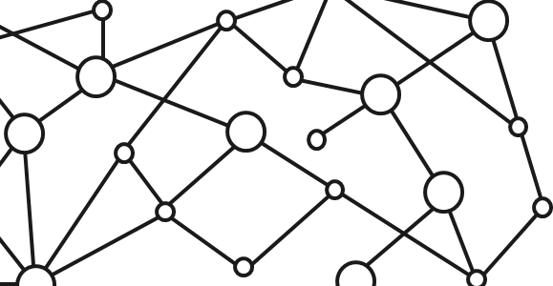
Microsoft 365 Platform
Extend Microsoft 365 experiences
web, device, and service apps
Build your experience
Documents
Pages
Conversations
Timeline
iOS/Android/Windows/Web
1
Microsoft Graph
Notes:
Our Office 365 developer vision focuses on the Users’ experience and their data. As a developer you can bring your applications into their user experience. With over 1.2+ billion users of Office Worldwide, this is a huge opportunity to provide a window into your applications. As well as being able to connect into their data and add intelligence to your applications. There are currently 850 million events created a month and a total of 470Pb+ of data stored in the service that can add value to for our Users’.

Slide 5
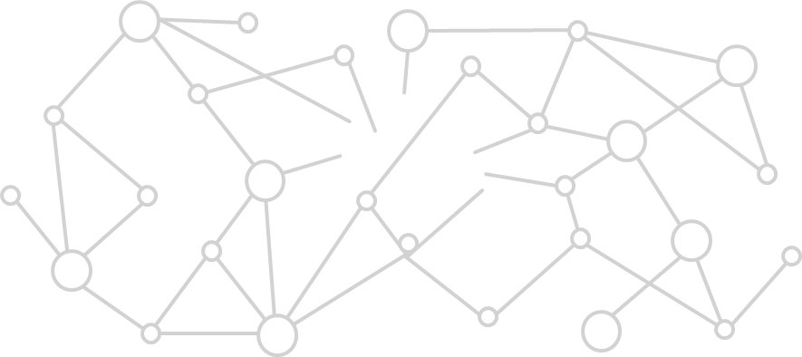
Microsoft Graph Gateway to your data in the Microsoft-cloud
https://graph.microsoft.com
Office 365
Windows 10
Enterprise Mobility + Security
Users, Groups, Organizations
Outlook
SharePoint
OneDrive
Teams
Planner
Excel
OneNote
Activities
Device Relay
Commands
Notifications
Azure AD
Intune
Identity Manager
Advanced Threat Analytics
Advanced Threat Protection
Mail, Calendar,
Contacts and Tasks
Sites and Lists
Drives and Files
Channels, Messages
Tasks and Plans
Spreadsheets
Notes, and more…
Identity Management
Access Control
Synchronization
Domains
Administrative Units
Applications and Devices
Advanced Threat Analytics
Advanced Threat Protection
Alerts
Policies
and more…

Slide 6

5 simple steps to your first Graph app
Try Graph Explorer (https://aka.ms/ge)
Browse the API reference and docs
Try a quickstart and training
Use the SDK
Register your app
Then…. happy coding!

Slide 7
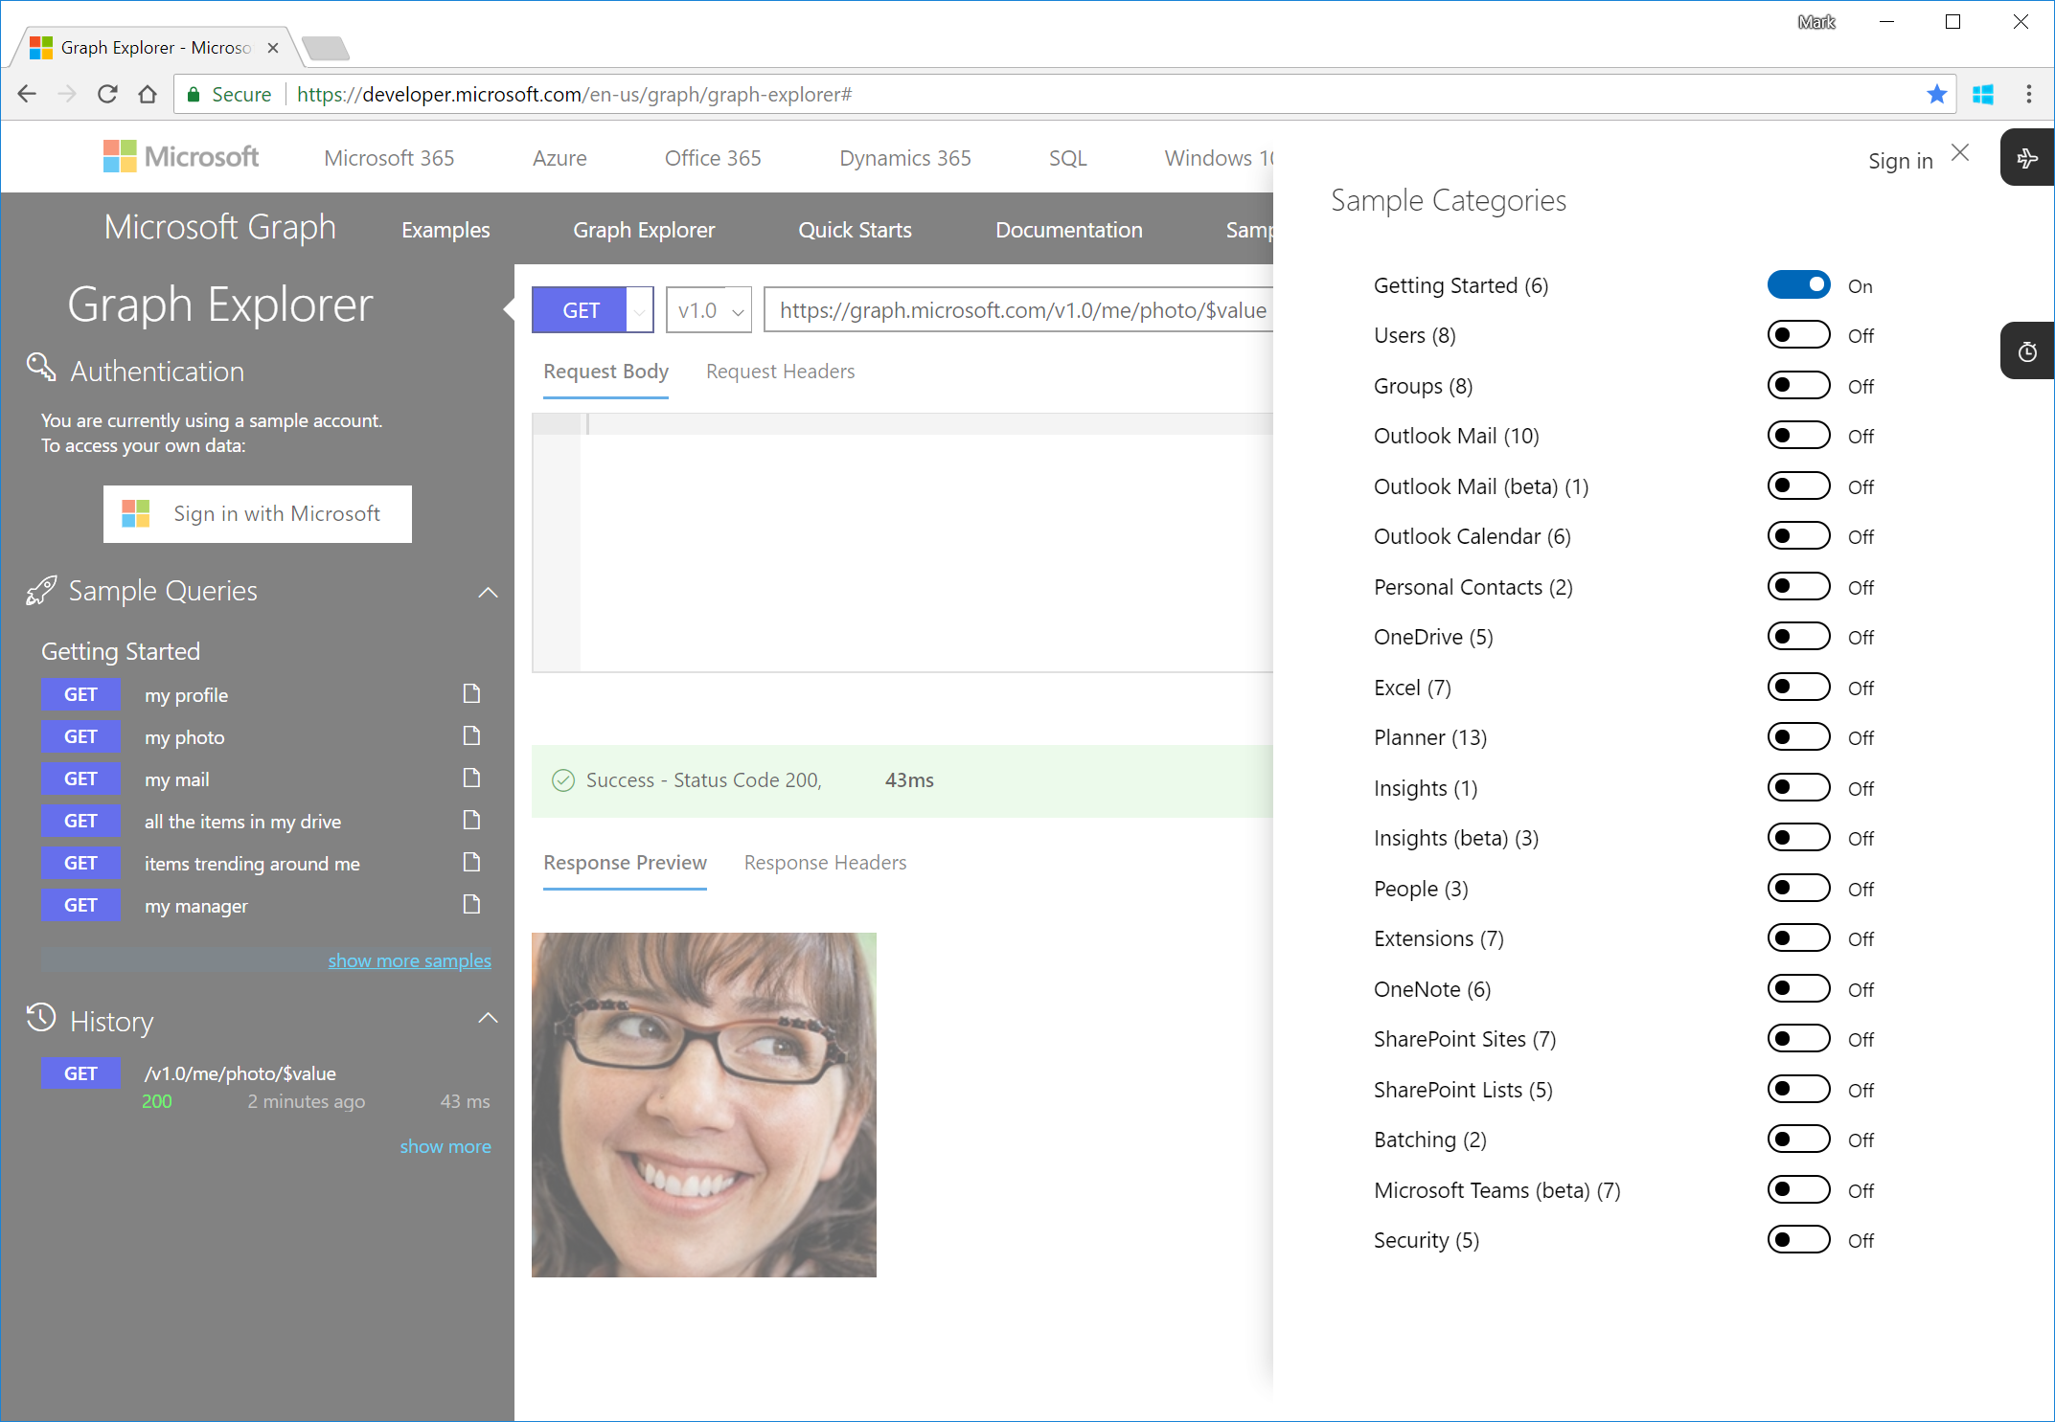
Step 1 | Try Graph Explorer (https://aka.ms/ge)
Quickly try requests from your browser
Supported accounts:
Demo (commercial)
Consumer (@outlook.com)
Commercial (@fabrikam.com)
And it’s open source
Caution: if you sign in, Graph Explorer can actually create/modify data

Slide 8
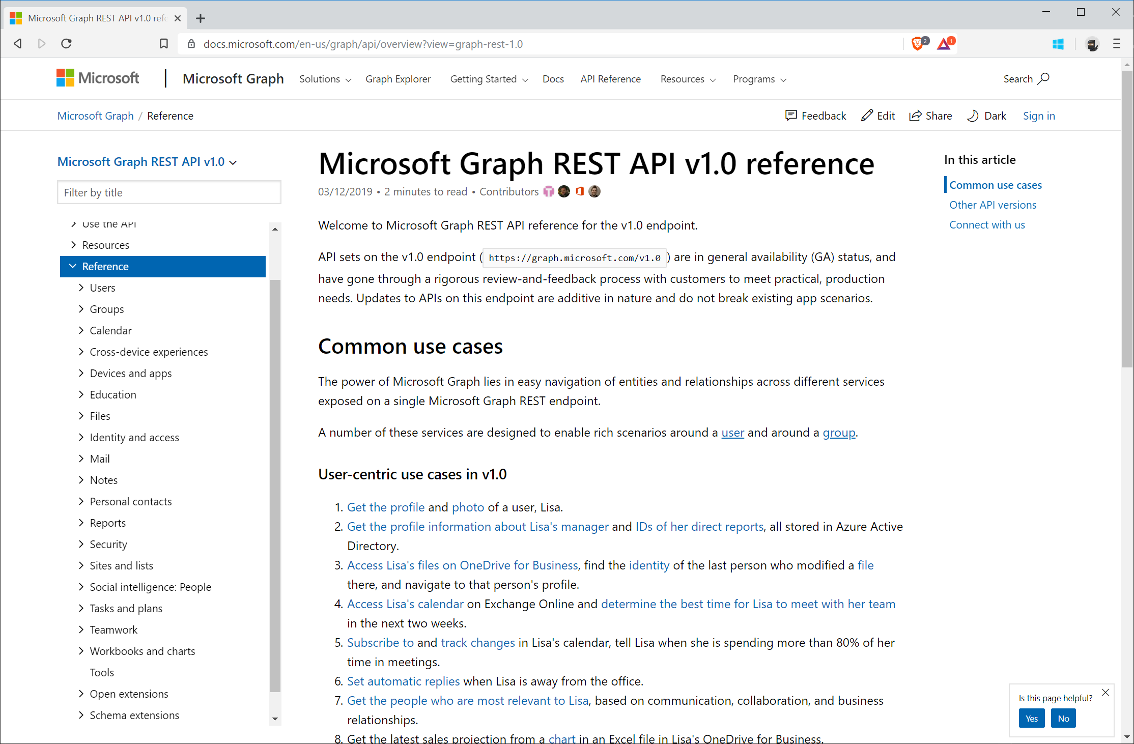
Step 2 | Browse the API reference

Slide 9
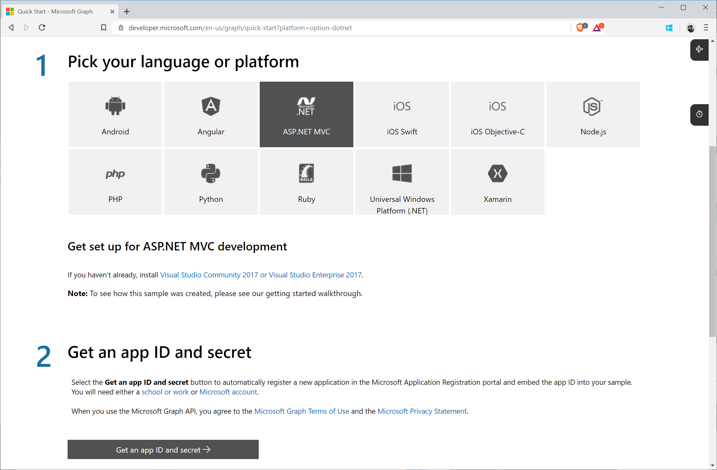
Step 3 | Try a quickstart

Slide 10
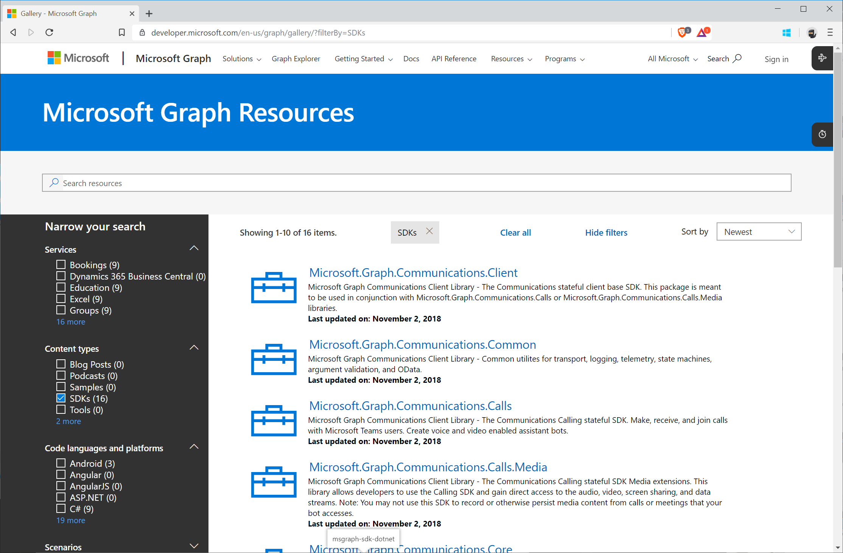
Step 4 | Download the SDK

Slide 11
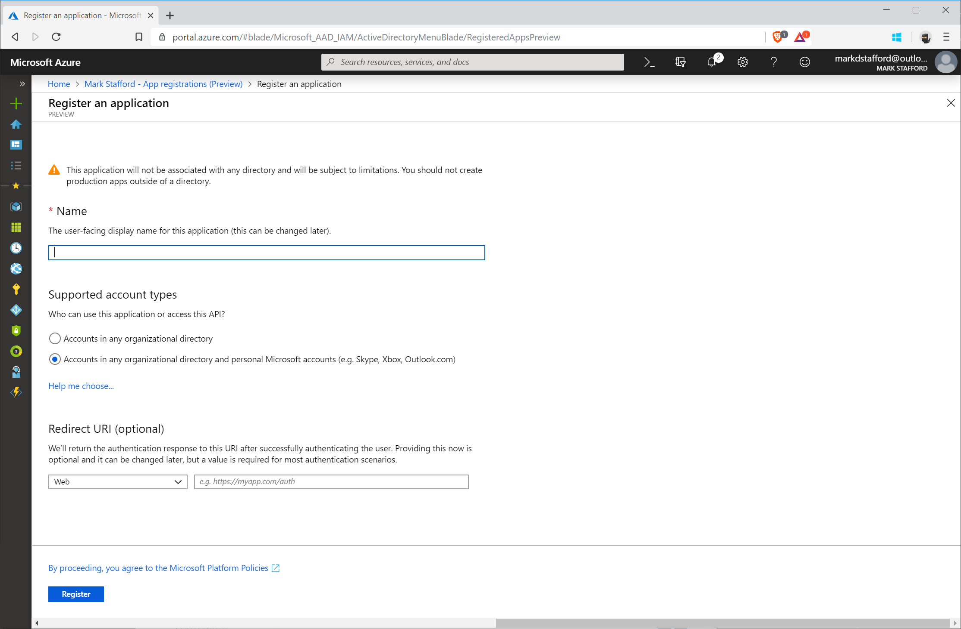
Step 5 | Register an app

Slide 12
App patterns summary
Web apps,
device & native
Bots & agents
Background
process & automation
Analytic apps
Scheduling app for flight crew
Lost luggage helper
New flight crew provisioning
Flight crew analysis

Slide 13
App patterns summary
BRK3082
BRK4011
BRK3079
BRK4010
Web apps,
device & native
Bots & agents
Background
process & automation
Analytic apps
Example | Scheduling app for flight crew | Lost luggage helper | New flight crew provisioning | Flight crew analysis
Auth | Interactive user | Device code | App only | App only
Challenge | Offline sync | Limited real estate | Throttling | Security and privacy
Decision | Middle tier or no | Bot or not | How to get changes | Where to unify data
Ingredients | Microsoft Graph toolkit | Adaptive cards | Azure Functions bindings | Microsoft Graph data connect

Slide 14
5 tips and tricks to become a Graph coder
Know the 7 basic operations
Learn the 7 basic query parameters
Watch for server-side pagination
Investigate other query patterns (webhook+delta)
Used least privileged permissions

Slide 15
TIP 1 | Know the 7 basic operations
Intent | HTTP METHOD | Description | Example
List | GET | List collection | GET /users
Get | GET | Get member of the collection | GET /users/{id}
Create | POST/PUT | Create new item in the collection | POST /users/ PUT /me/activities/{id}
Update | PATCH/PUT | Update item | PATCH /users/{id} PUT /me/activities/{id}
Delete | DELETE | Delete item | DELETE /users/{id}
Invoke | POST | Invoke operations | POST /domains/{id}/verify
Batch | POST | Execute multiple requests | POST /$batch

Slide 16
POST/PATCH/PUT | no response required
If your code doesn’t need to get a response, then opt out
Don’t send unnecessary data over the wire
Tip
Use HTTP
Prefer return=minimal request header
Some services always return 204 No content for PATCH and PUT

Slide 17
TIP 2 | Learn the 7 basic query parameters
Value | Description | Example
$filter | Filters results (rows) | /users?$filter=startsWith(givenName,’J’)
$select | Filters properties (columns) | /users?$select=givenName,surname
$orderBy | Orders results | /users?$orderBy=displayName desc
$top | Sets the page size of results | /users?$top=10
$expand | Retrieves related resources | /groups?$expand=members
$count | Retrieves the total count of matching resources | /me/messages?$top=2&count=true
$search | Returns results based on search criteria. Currently supported on messages and person collections | /me/messages?$search=pizza

Slide 18
Querying data | Use projections
Choose the properties your app really needs and no more
Don’t send unnecessary data over the wire
Tip
Use $select
GET https://graph.microsoft.com/v1.0/users?
$select=givenName,mail

Slide 19
Querying data | Use filters
Choose the records your app really needs and no more
Don’t send unnecessary data over the wire
Tip
Use $filter
GET https://graph.microsoft.com/v1.0/users?
$filter=department eq ‘Sales’ & $select=givenName,mail

Slide 20
TIP 3 | Watch for server-side pagination
Graph uses server-side page size limits
When querying collections, Graph may return the results in many pages
Always expect an @odata.nextLink property in the response
Contains the URL to the next page

Slide 21
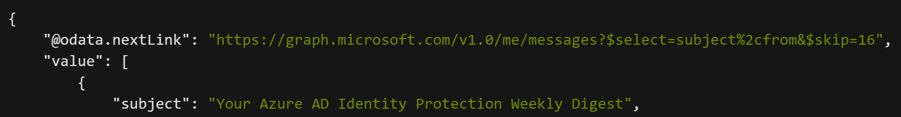
Request
Response
1.
Always handle the possibility that the responses are paged in nature
2.
Follow the @odata.nextLink to obtain the next page of results
3.
Final page will not contain an @odata.nextLink property
4.
Treat the entire URL as an opaque string

Slide 22
TIP 4 | Track changes | Webhooks + Delta query
Scenario
Same scenarios as before, but if you need to optimize further…
Tips
Use webhook notifications as the trigger to make delta query calls
Put notifications in a queue for later processing
Why
Difficult to figure out optimal polling interval

Slide 23

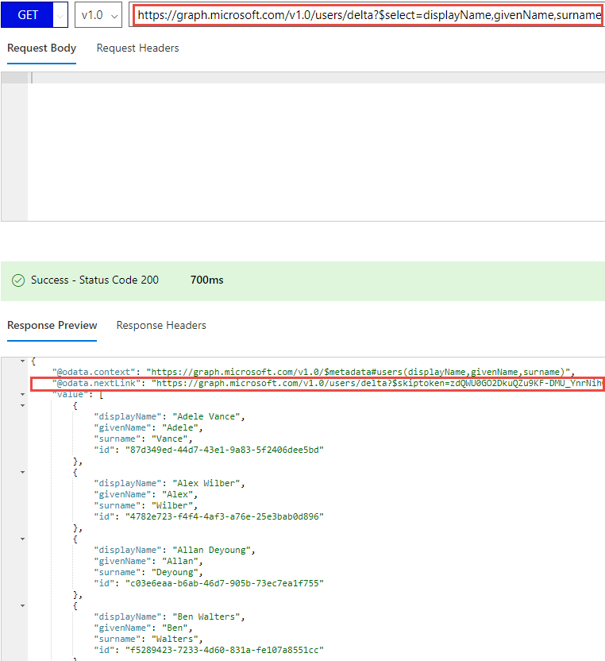
Change tokens with deltaLink
Discover newly created, updated, or deleted entities without a full read of the target resource
Useful for synchronizing changes to a local data store
Requires permission to read the requested resource
@odata.nextLink
Presence of nextLink indicates more data is available
@odata.deltaLink
Presence of deltaLink indicates no more data to be returned
Contains deltaToken, save this for future queries
If no changes have occurred, the same deltaToken is returned with no results

Slide 24
Typical call pattern to track changes in a resource collection
Application
https://graph.microsoft.com/v1.0
/{resource}/delta?$select=id,displayName
{“@odata.nextLink”:”https://graph.Microsoft.com/v1.0/{resource}/delta?$skipToken=ABC”,
“value”:[{“id”:”1”,”displayName”:”foo”}, {“id”:”2”,”displayName”:”bar”}]}
https://graph.Microsoft.com/v1.0/{resource}/delta?$skipToken=ABC
{“@odata.deltaLink”:”https://graph.Microsoft.com/v1.0/{resource}/delta?$deltaToken=DEF”,
“value”:[{“id”:”3”,”displayName”:”baz”}]}
After webhook notification
https://graph.Microsoft.com/v1.0/{resource}/delta?$deltaToken=DEF
{“@odata.deltaLink”:”https://graph.Microsoft.com/v1.0/{resource}/delta?$deltaToken=XYZ”,
“value”:[{“id”:”1”,”displayName”:”My data was updated”}]}

Slide 25
TIP 5 | Used least privileged permissions
Use least privilege! Only request permissions which are absolutely necessary, and only when you need them
Be thoughtful when configuring your app! This will directly affect end user and admin experiences, along with app adoption and security
When building a multi-tenant app, expect customers to have various application and consent controls in different states
Don’t use AppOnly for user interactive scenarios

Slide 26
Microsoft Graph at Build 2019 | Data sets
Generally available ( /v1.0 ) | Preview ( /beta )
Office 365 Exchange (get schedule) SharePoint (get item analytics) Teams APIs EMS Security (secure score) AAD (audit and sign in logs, identity providers, groups naming policy, group based licensing APIs, nested membership expansion on groups, export personal data) Microsoft Graph data connect | Office 365 Exchange (MIME messages, MIME item attachments, raw file attachments) SharePoint (security events webhooks) OneDrive (follow/unfollow documents, expiring links in permissions API) Teams (1:1 chat messages, shifts management) Connectors private preview EMS Security (Logic App/Flow/Power Apps connectors, Power BI connector, Jupyter Notebooks, threat indicators, security actions) AAD (application sign-in reports, custom sign-up and sign-in policies in Azure AD B2C, risky user and history) Dynamics Business Central (Financials)

Slide 27
Microsoft Graph at Build 2019 | DevX Tooling
Generally available | Preview
SDK releases .NET – Version 1.15 Java – Version 1.3 Android Support Java – Version 1.X lightweight core library (*new*) JavaScript – Version 1.6.0 Objective C – Version 1.0 (*new*) New SDK features (across languages) Retry and Redirect Support Download decompression support Page iterator Task Large File Upload Task Client Factory Docs SDK Getting started docs Code snippets in reference documentation (.NET, Java) | Updated SDKs for Beta API .NET PHP Typescript New SDK features (across languages) Microsoft Graph Authentication Providers for MSAL Microsoft Graph Toolkit Postman collections Docs Embedded try experience (coming soon)
SDKs and Toolkit are all OSS on https://github.com/microsoftgraph

Slide 28
Microsoft Graph Data Connect
Introducing Microsoft Graph data connect & configuring your Office 365 tenant

Slide 29

Microsoft Graph Data Connect
What is Microsoft Graph data connect?
What types of scenarios does Microsoft Graph data connect enable?
Configuring your Office 365 tenant to enable Microsoft Graph data connect

Slide 30
What are customers trying to do?
Better CRM
Security and Fraud
Optimize Your Organization​
Build & Integrate Intelligent Workflows with O365​
Mine your org network for a customer introduction
Opportunity health assessment​
Detect fraud with productivity and communication data
Mine communication for interaction patterns with users outside the organization
Find an expert​
Automate knowledge base creation​
Understand resource utilization within your organization
Case management
Questions & answers bot
Support ticket management
Analytics
AI and ML
Index and Search

Slide 31
Challenging scenarios with the Microsoft Graph
Today’s most interesting data-driven applications
require reasoning & analysis over massive datasets
built by extracting data from Office 365 via Microsoft Graph APIs
Microsoft Graph is optimized for simple, real-time, entity centric queries, not:
Data Access in bulk - requires expensive engineering
Data Privacy is at risk - given the current all-or-nothing consent models
Data Security & Data Governance - entirely up to the experience author

Slide 32







Microsoft Graph Data Connect
Apply defined data controls
Securely extend Office 365 data to Azure
Enable big data and machine learning
Data at scale
Office 365
Azure
Customer data
Granular consent
Product data
Security & Governance
Industry data
Customer’s MS Cloud

Slide 33
What is Microsoft Graph Data Connect?
Creates a new model for data access & hosting applications within the customer’s control
Allows developers to build intelligent applications and experiences using Office 365 data & Azure resources
Application access to customer data requires explicit customer approval
Microsoft Graph remains the best approach for enabling end-user task centric apps

Slide 34
Comparing Microsoft Graph APIs & Microsoft Graph Data Connect
 | Graph APIs | Graph data connect
Access scope | Single use / entire tenant | Many users / groups
Access pattern | Real time | Recurrent schedule
Data operations | Operates on data master | Operates on cache of the data
Data protection | Data is protected while in Microsoft 365 | Data protection is extended to the cache of data in your Azure subscription
User consent | Self; resource types | None
Admin consent | Entire organization; resource types | Select groups of users; resource types & properties; excludes users
Access tools | RESTful web queries | Azure Data Factory

Slide 35
Graph Data Connect - Enabling Scenarios
Data resides in Office 365
Azure Data Factory extracts data via Graph data connect
Graph data connect enforces only approved requests for data
Extracted data is stored in Azure:
Azure Blob Storage
Azure Data Lake
Create solutions that leverage the data in Azure

Slide 36



Insight examples for organizations
Build a better CRM. Connect your organizational network for a customer introduction.
Engage your customers
Transform products
Build & integrate intelligent workflows with Office 365 for your business and industry.​ Leverage knowledge to improve legal case management.
Your Data +
Workplace Analytics
Azure
Connect employees with the best expert. Abstract trends to automate knowledge management.
Optimize your organization​
Streamline operations
Detect fraud with productivity and communication data.
Connect interaction patterns with users outside the organization.

Slide 37
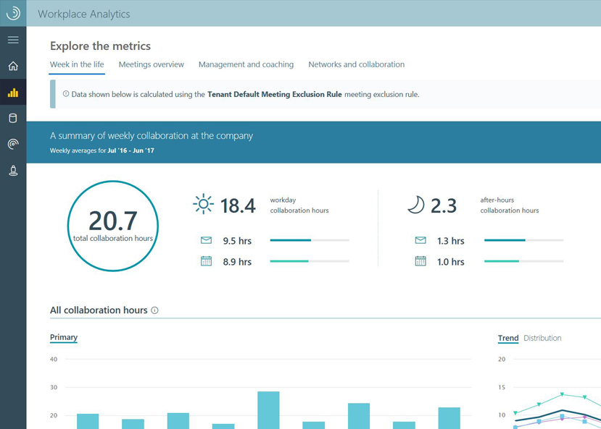
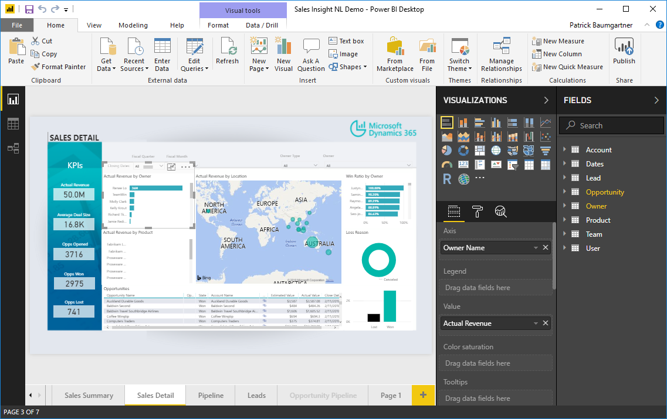
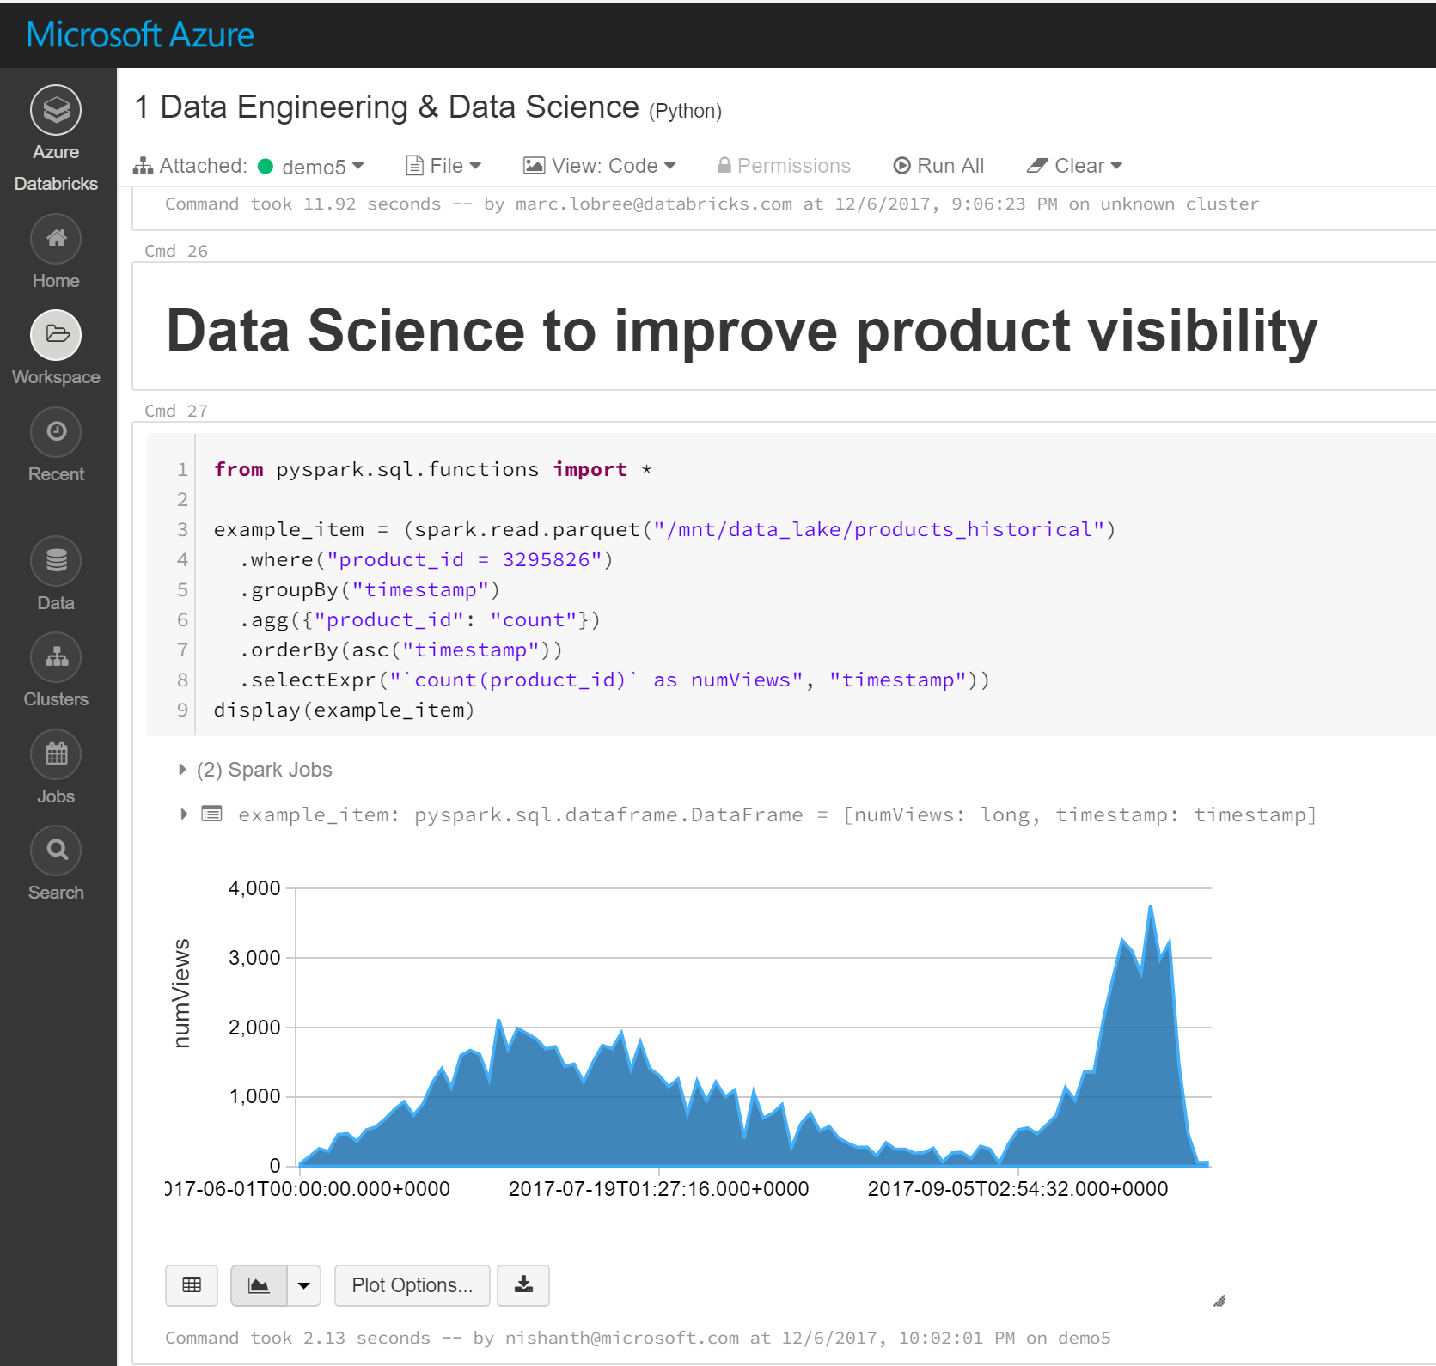


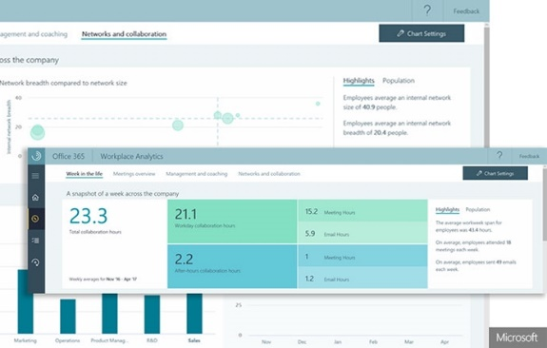
Create insight applications in the Enterprise
Anyone can develop custom insights using key organizational data
Decision makers
Business analysts
Developers
Workplace Analytics
Create self-service customization
Harness full AI tool suites and frameworks
Insights apps
Unlock valuable insights in hours

Slide 38
Demo Configuring Your Office 365 Environment Extract the Data https://portal.office.com/adminportal/home#/Settings/PrivilegedAccess

Slide 39

Summary
What is Microsoft Graph data connect?
What types of scenarios does Microsoft Graph data connect enable?
Configuring your Office 365 tenant to enable Microsoft Graph data connect
Create a data sink where extracted data will go
Create Azure Data Factory pipeline
Approve data request

Slide 40
Reading further
Consume Microsoft Graph (tutorial)
https://docs.microsoft.com/sharepoint/dev/spfx/use-aad-tutorial
Microsoft Graph
https://developer.microsoft.com/graph
Microsoft Graph JavaScript SDK
https://github.com/microsoftgraph/msgraph-sdk-javascript
SharePoint Framework Documentation
https://docs.microsoft.com/sharepoint/dev/spfx/sharepoint-framework-overview
Use the MSGraphClient to Connect to Microsoft Graph
https://docs.microsoft.com/sharepoint/dev/spfx/use-msgraph
Microsoft Graph
https://developer.microsoft.com/graph
Graph Explorer
https://developer.microsoft.com/graph/graph-explorer
Microsoft Graph JavaScript SDK
https://github.com/microsoftgraph/msgraph-sdk-javascript
SharePoint Framework Documentation
https://docs.microsoft.com/sharepoint/dev/spfx/sharepoint-framework-overview
Use the MSGraphClient to Connect to Microsoft Graph
https://docs.microsoft.com/sharepoint/dev/spfx/use-msgraph

